Slide 1

Introduction and Motivation
Literature Overview
Experiment
Analysis
Explainable AI: The SHAP Algorithm
Asad Aslam
University of Catania
September 25th, 2024
Explainable AI: The SHAP Algorithm

Slide 2
Introduction and Motivation
Literature Overview
Experiment
Analysis
Collaboration Acknowledgment
This thesis is a joint work with my colleague and friend, Sameer Afzal. While this presentation focuses on my contributions using SHAP,
I utilized the results from Sameer’s work with LIME to perform a comparative analysis between SHAP and LIME.
Explainable AI: The SHAP Algorithm

Slide 3
Introduction and Motivation
Literature Overview
Experiment
Analysis
Overview
Introduction and Motivation
Literature Overview
Experiment
Analysis
Explainable AI: The SHAP Algorithm

Slide 4
Introduction and Motivation
Literature Overview
Experiment
Analysis
Background
Machine Learning Complexity and Challenges
Trust and Ethical Concerns
Explainable AI (XAI) to the Rescue
SHAP: A Popular XAI Tool
Explainable AI: The SHAP Algorithm

Slide 5
Introduction and Motivation
Literature Overview
Experiment
Analysis
Research Objectives
Gain a deep understanding of SHAP
Evaluate SHAP’s performance on real-world data set.
Compare SHAP with other XAI technique.
Demonstrate SHAP’s practical utility using Python for a hands-on project.
Explainable AI: The SHAP Algorithm

Slide 6
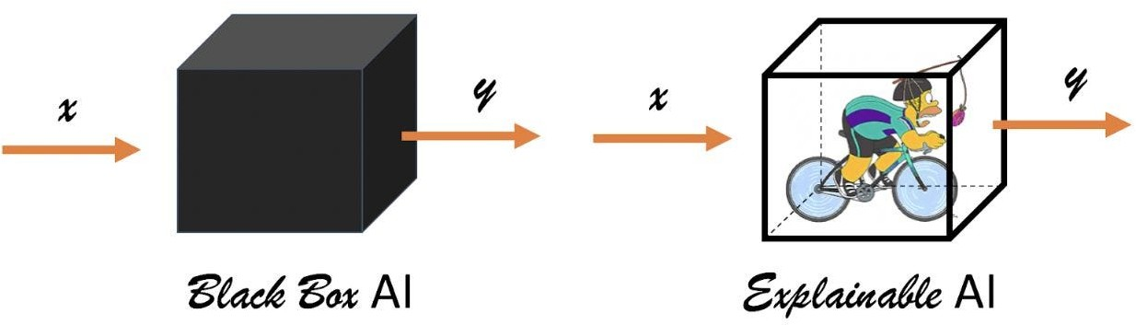
Introduction and Motivation
Literature Overview
Experiment
Analysis
XAI: Explainable Artiﬁcial Intelligence
Glass Box VS Black Box
Glass Box Algorithms: Decision Tree, Linear Regression, etc.
Black Box Algorithms: Neural Networks, Random forest, SVM, etc.
XAI focuses on making AI decisions transparent and understandable.
Explainable AI: The SHAP Algorithm

Slide 7
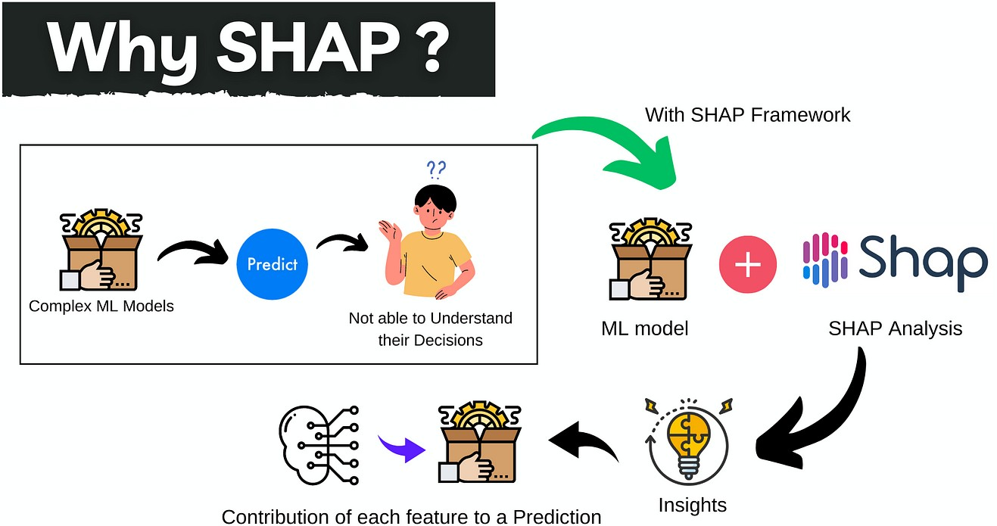
Introduction and Motivation
Literature Overview
Experiment
Analysis
SHAP
SHAP, based on Shapley values from cooperative game theory.
SHAP values measure the impact of each feature on a model’s prediction.
Features are treated as “players” contributing to the prediction.
Explainable AI: The SHAP Algorithm

Slide 8
Introduction and Motivation
Literature Overview
Experiment
Analysis
Student Dropout Data set
Data set source: UCI Machine Learning Repository.
The data set focuses on identifying students at risk of dropping out, using machine learning for early intervention.
Features: 36 different features, including demographic and academic data.
Target variable: Predicting whether a student will drop out, stay enrolled, or graduate.
Machine learning models applied: Random Forest, SVM, Neural Network, Gradient Boosting, XGBoost.
Explainable AI: The SHAP Algorithm

Slide 9
Introduction and Motivation
Literature Overview
Experiment
Analysis
Model Accuracy
Model | Accuracy
Random Forest | 0.8628
SVM | 0.8515
Neural Network | 0.8048
Gradient Boosting | 0.8560
XGBoost | 0.8470
Explainable AI: The SHAP Algorithm

Slide 10
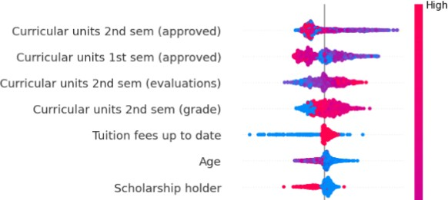
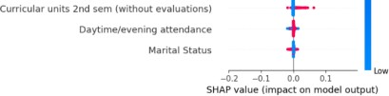
Introduction and Motivation
Literature Overview
Experiment
Analysis
SHAP Summary Plot
Explainable AI: The SHAP Algorithm

Slide 11
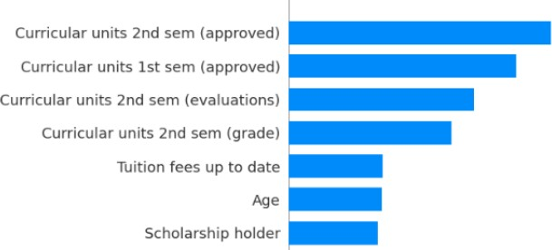
Introduction and Motivation
Literature Overview
Experiment
Analysis
Average Impact of Features
Explainable AI: The SHAP Algorithm

Slide 12
Introduction and Motivation
Literature Overview
Experiment
Analysis
SHAP vs LIME: Key Feature Comparison
Curricular units 2nd semester (approved), Both SHAP and LIME identify this as the most important feature inﬂuencing dropout probability.
Scholarship holder status, LIME shows this feature as highly inﬂuential in reducing dropout probability. In contrast, SHAP downplays its importance, indicating a difference in how the methods rank this feature across the dataset.
Academic performance, Both methods emphasize the importance of grades and evaluations from the ﬁrst and second semesters.
Explainable AI: The SHAP Algorithm

Slide 13
Introduction and Motivation
Literature Overview
Experiment
Analysis
Conclusion
SHAP explains complex models, improving transparency and trust in AI.
It identiﬁes key factors both globally and for individual cases, making it valuable in ﬁelds like academic progress, healthcare and ﬁnance.
Compared to LIME, SHAP provides more consistent explanations, making it preferable for critical applications.
The study shows that being able to understand how models make decisions is essential for using AI widely, especially when those decisions affect people’s lives.
Explainable AI: The SHAP Algorithm

Slide 14
Introduction and Motivation
Literature Overview
Experiment
Analysis
Acknowledgment of Advisor
I would like to express my sincere gratitude to Professor Giovanni Gallo for his invaluable guidance and support throughout this thesis. His expertise, insightful feedback, and encouragement were instrumental in shaping the direction of this Thesis.
Explainable AI: The SHAP Algorithm

Slide 15
Thanks for your attention

